Slide 1
Unity overview Advanced Game Design & Development
Danny Jugan

Slide 2
Homework #1 Discussion
Homework
Research any game franchise that started out in 2D, then made the transition to 3D. Compare the success of the two games (2D vs. 3D) and cite reasons (not your own) why the 3D game(s) was/were more or less successful than its 2D version(s). Specifically compare the design features of the games using your technical knowledge of game design principles.
Presentation & Discussion

Slide 3
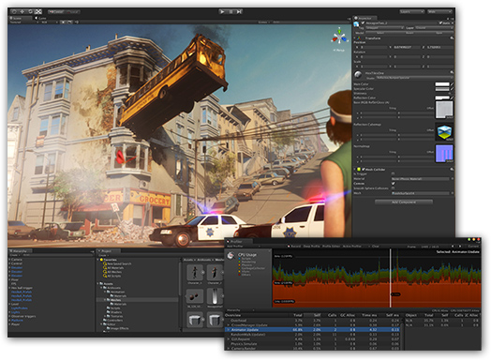
Unity overview
http://unity3d.com/unity/download
Today we’ll look at familiarizing ourselves with various parts of the UI and how to get started with creating your first project.
I’ll flip back and forth from Unity to a list of topics to cover.

Slide 4
Unity overview
Parts of the UI and their use
Hierarchy, Inspector
Adding Game Objects
Manipulating Game Objects
Lighting
Cameras
Physics (rigid bodies)
Scripts

